Slide 1
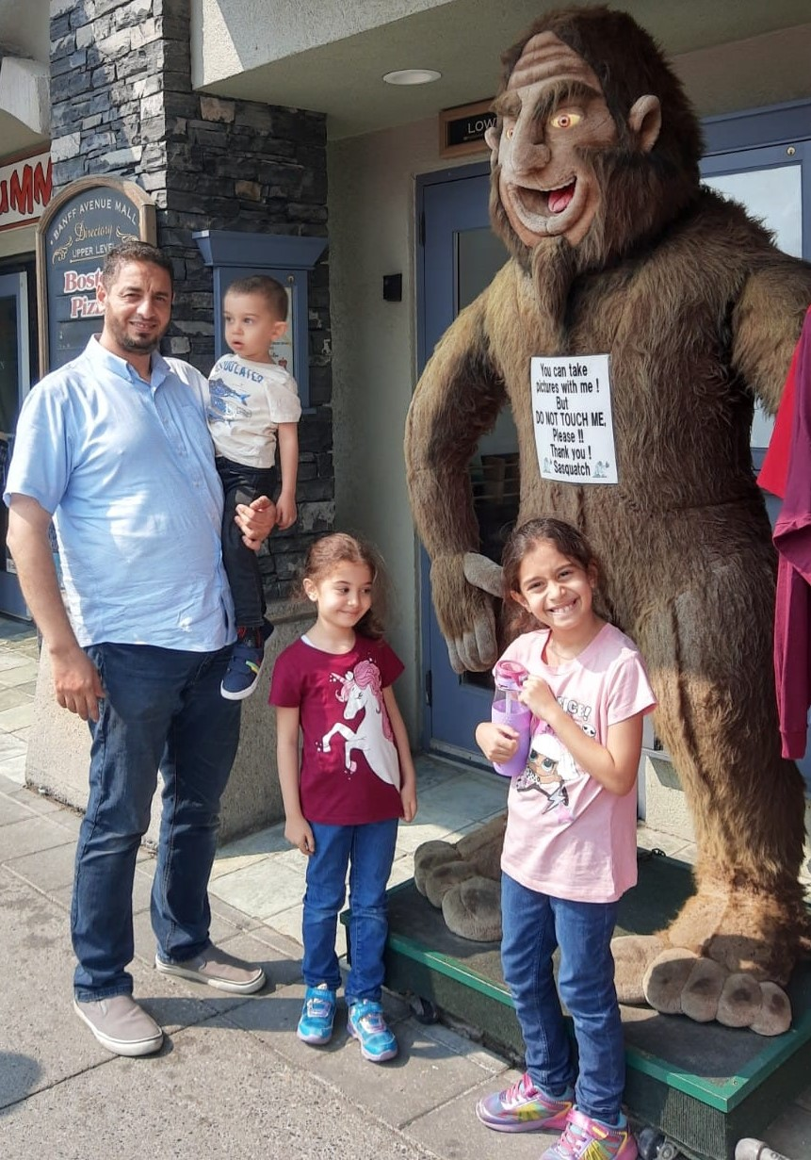
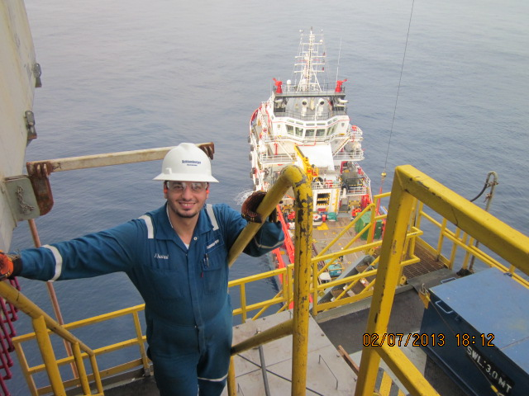
Who I am?
Hussam
Al Hamdan

Slide 2
Age Detection
Business Case and Motivation
Important task in intelligent applications:
-Access control (Restricted age venues: Bars, Casino)
-Human-computer interaction (Shopping Mall, Transportation Station).
-Law enforcement, Visual surveillance (Airport, security services)
-Marketing intelligence (Netflix, Amazon, Social media platforms)

Slide 3
Age Detection
Deep Learning Model
Convolutional Neural Networks (CNN)
Computer Vision (OpenCV)
Download
Download The Data
Prepare
Prepare The Data
Build
Build The Model
Train
Train The Model
Deploy
Deploy DL Model

Slide 4
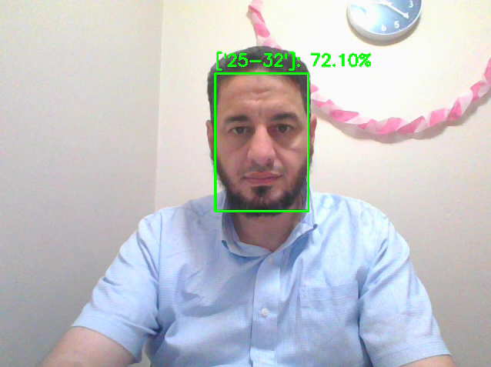
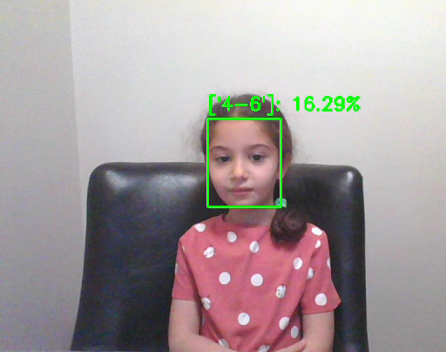
Age Detection Deployment
Github: https://github.com/LightBeacon/Age-Detection.git
Please: use Final_Project_Demo.py under any python friendly environment

Slide 5
Challenges & Future Development
1. Data processing
2. Computation expensive
3. Model training and parameters tunning
4.Model integration with recommender engines

